Slide 1




Accelerating Fast Fourier Transform with half-precision floating point hardware on GPU
Anumeena Sorna & Xiaohe Cheng
Mentor: Eduardo D’Azevedo & Kwai Wong

Slide 2
BACKGROUND
Our project concerns a new implementation of the classical discrete Fourier Transform and the fast Fourier Transform algorithm.
INFORMATION

Slide 3
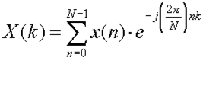

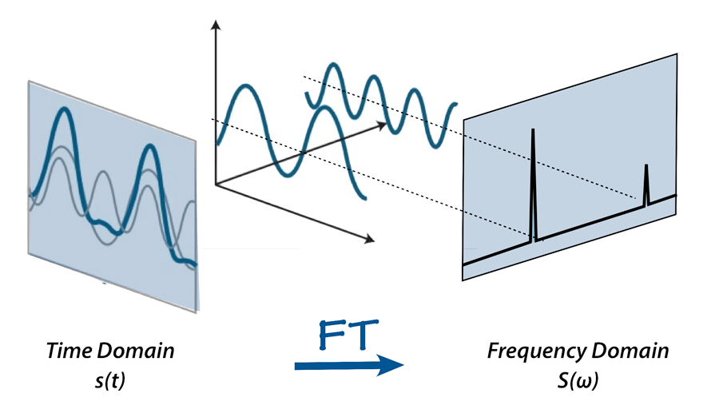
Discrete Fourier Transform
Converts time domain signals to frequency domain signals according to the equation:
Applications in:
Convolution
Filtrering
Image Processing
Inverse DFT:
Source: MRI Questions http://mriquestions.com/fourier-transform-ft.html

Slide 4
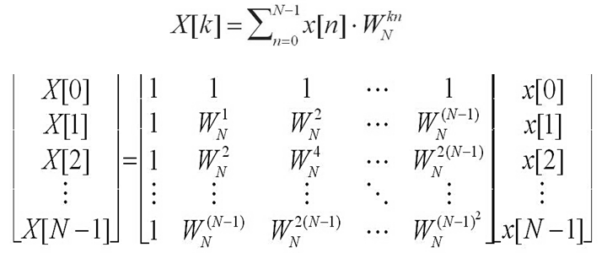
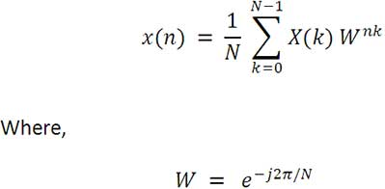
Discrete Fourier Transform
DFT can also be represented in matrix form:
Linear Transformation!

Slide 5
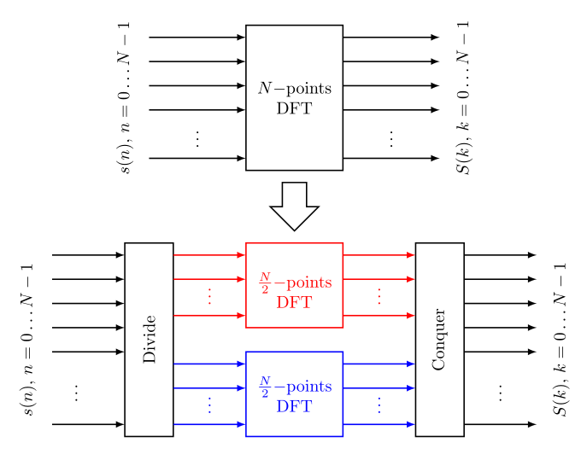
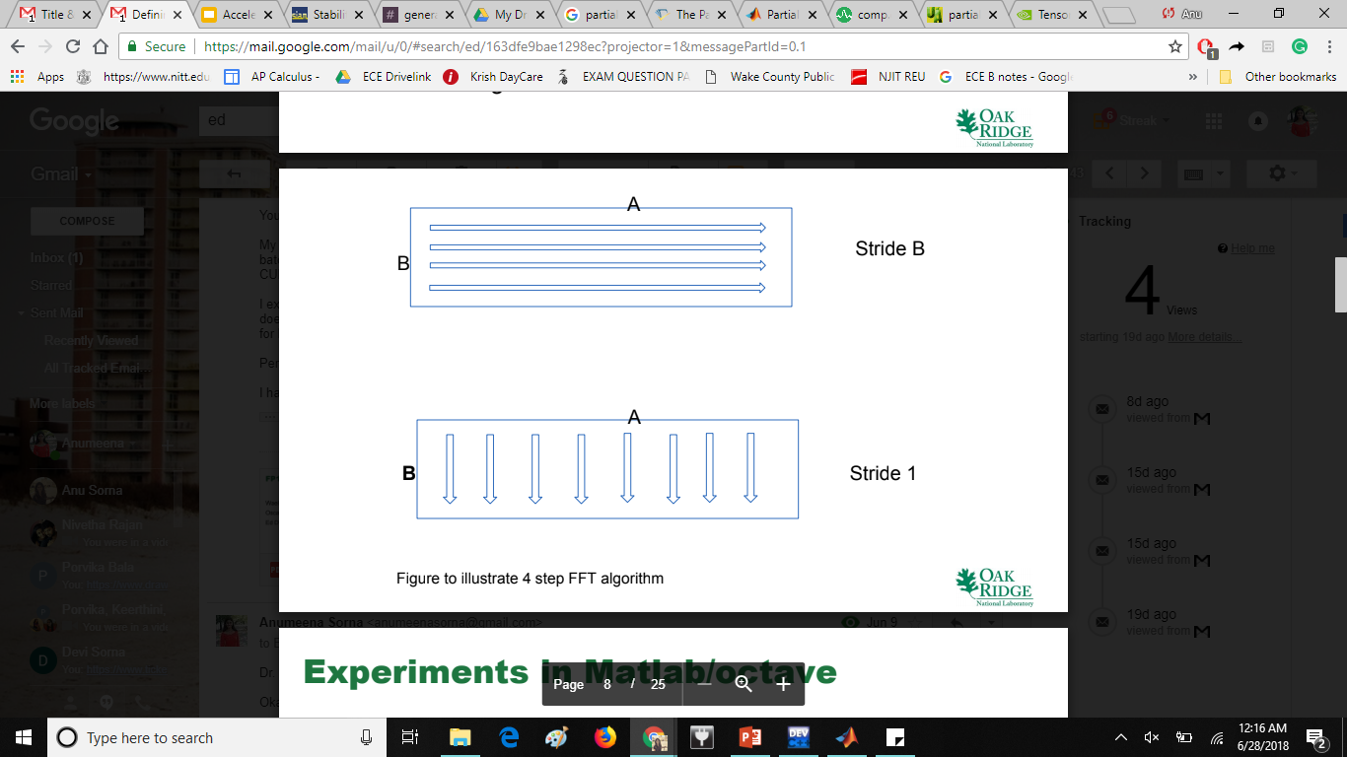
The Fast Fourier Transform
Divide and Conquer Principle
FFT Computation requires: ~N*log(N) whereas DFT: N^2
4 Step Algorithm
Data represented as B by A matrix
1. Perform B number of A-point FFT (in parallel, stride B)
2. Perform scaling by twiddle factors exp(-(2π/N)*j*k*I)
3. Perform A number of B-point FFT (in parallel, stride 1)
4. Transpose data to form A by B matrix
Source: DSPlib http://en.dsplib.org/content/fft_introduction/fft_introduction.html

Slide 6
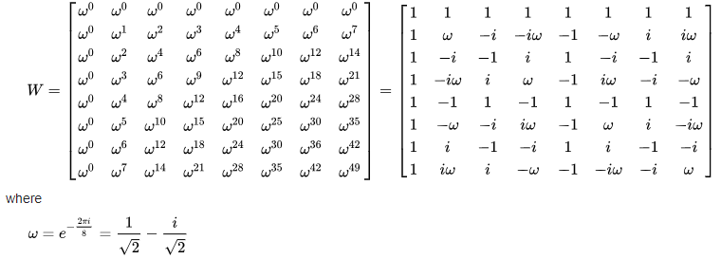
Example Problem - DFT
x=[1,2,3,4,5,6,7,8]
Matrix Multiplying x and W,
X = [36, 4 + 9.7i, -4 + 4i, -4 + 1.7i, -4, -4 – 4i, -4 – 9.7i]

Slide 7
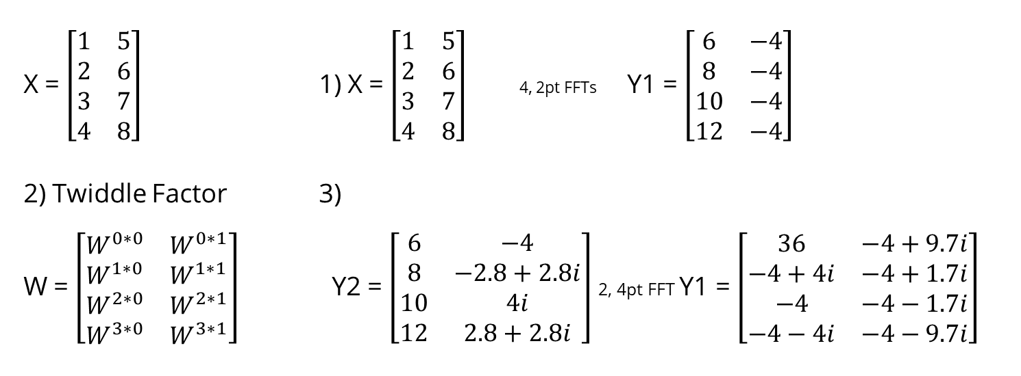
Example Problem - FFT
X = $\left[\begin{matrix}1 & 5 \\ 2 & 6 \\ 3 & 7 \\ 4 & 8\end{matrix}\right]$ 1) X = $\left[\begin{matrix}1 & 5 \\ 2 & 6 \\ 3 & 7 \\ 4 & 8\end{matrix}\right]$ 4, 2pt FFTs Y1 = $\left[\begin{matrix}6 & −4 \\ 8 & −4 \\ 10 & −4 \\ 12 & −4\end{matrix}\right]$
2) Twiddle Factor 3)
W = $\left[\begin{matrix}W^{0∗0} & W^{0∗1} \\ W^{1∗0} & W^{1∗1} \\ W^{2∗0} & W^{2∗1} \\ W^{3∗0} & W^{3∗1}\end{matrix}\right]$ Y2 = $\left[\begin{matrix}6 & −4 \\ 8 & −2.8+2.8i \\ 10 & 4i \\ 12 & 2.8+2.8i\end{matrix}\right]$ 2, 4pt FFT Y1 = $\left[\begin{matrix}36 & −4+9.7i \\ −4+4i & −4+1.7i \\ −4 & −4−1.7i \\ −4−4i & −4−9.7i\end{matrix}\right]$

Slide 8
RESEARCH
To utilize the tensor core hardware by NVIDIA
To implement computational tricks
To consider domain-specific requirements
GOALS

Slide 9
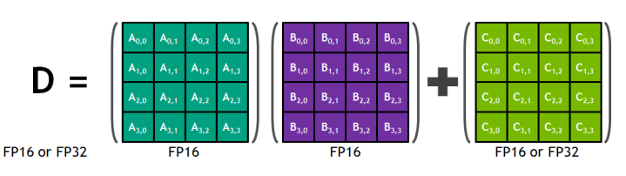
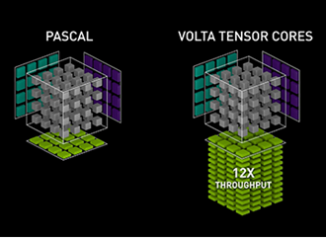
Volta Architecture
Figure 1. Tensor core 4*4*4 matrix multiply and accumulate. Source: https://devblogs.nvidia.com/programming-tensor-cores-cuda-9/
Tensor cores give a 8x increase in throughput using half precision input. This has been utilized by cuBLAS and cuDNN library to accelerate matrix multiplication and artificial intelligence training.
Source: https://www.nvidia.com/en-us/data-center/tensorcore/

Slide 10
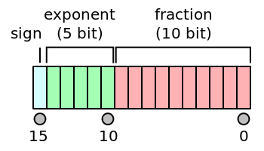
Challenge
The representation range of FP16 is roughly 6*10^(-5) to 6*10^5, which is much more limited than single precision. This degrades the precision of operations and may cause frequent overflows.
Figure 1. Half precision floating point (FP16) number representation. Source: https://en.wikipedia.org/wiki/Half-precision_floating-point_format

Slide 11
Single to Half Precision
To keep the accuracy, we split a FP32 number to the scaled sum of two FP16 number, and make use of the property that Fourier Transform is a linear operation:
x_fp32(:) = s1_fp32 * x1_fp16(:) + s2_fp32 * x2_fp16(:)
and
X_fp32(:) = s1_fp32 * X1_fp16(:) + s2_fp32 * X2_fp16(:)
where scaling factor s1 and s2 are determined by the maximum absolute value in the original vector.

Slide 12

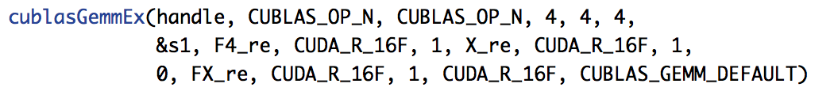
GPU Implementation
We first wrote Matlab code to test the algorithm, and will proceed to implement it with C and CUDA. We call cuBLAS library for matrix-matrix multiplication.

Slide 13
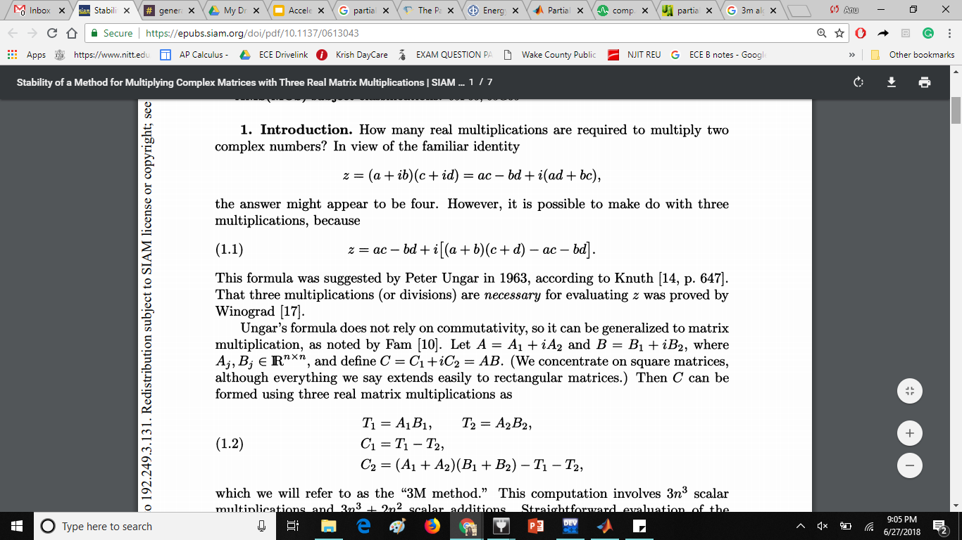
Further acceleration
3M algorithm, 2D fft & in-place transformation, partial FFTs
3M Algorithm
Partial FFTs
In some applications we only require a portion of the matrix with FFT results
An algorithm can be used to efficiently compute only required portions instead of usual method of computing all and discarding unnecessary FFT values

Slide 14
Current Progress & Future Work
FFT Algorithm
MATLAB to C conversion
GPU optimization
Partial FFT
Algorithm
C to CUDA conversion
FFT Library

Slide 15
Q & A
Any questions?

